Slide 1

Gwinnett Bus – Milestone 2
Team 3:
Sam Bostian, Michael Rizig, Charlie McLarty, Brian Pruitt, Allen Roman
Notes:
Milestone 2: Initial development of Kafka consumer, producer and basic data processing.
Development of database interaction and event logging.

Slide 2

Overview
Recap
Updated Dataflow
Server Process Details
Data Generation
Installation Guide
Dataflow Demonstration (Event logging, Updating, Queries)
Data Validation Demonstration (Valid vs Invalid Data Recognition and Flagging)
Next Steps

Slide 3
Kafka Producer Recap
Step 1: Import Kafka native API for python
from kafka import KafkaProducer
Step 2: Define server address and desired topic on said server:
TOPICNAME = 'GCPS_Bus_Monitoring' SERVERIP = 'localhost:9092'
Step 3: Connect to the server via Kafka producer object and pass IP
producer = KafkaProducer(bootstrap_servers=SERVERIP)
Step 4: Publish data to the topic
producer.send(TOPICNAME, b'data') producer.flush()

Slide 4
Kafka Consumer Recap
Consumer.py: “Consumes” the real-time data from the producer.
Step 1: Import Kafka native API for python
from kafka import KafkaConsumer
1
Step 2: Define server address and desired topic on said server:
TOPICNAME = 'GCPS_Bus_Monitoring' SERVERIP = 'localhost:9092' #insert server ip here
2
Step 3: Connect to the server via Kafka consumer object and pass desired topic
consumer = KafkaConsumer(TOPICNAME, bootstrap_servers=SERVERIP)
3
Step 4: Parse data:
for messages in consumer: process(messages['value'])
4

Slide 5
Server process overview

Slide 6
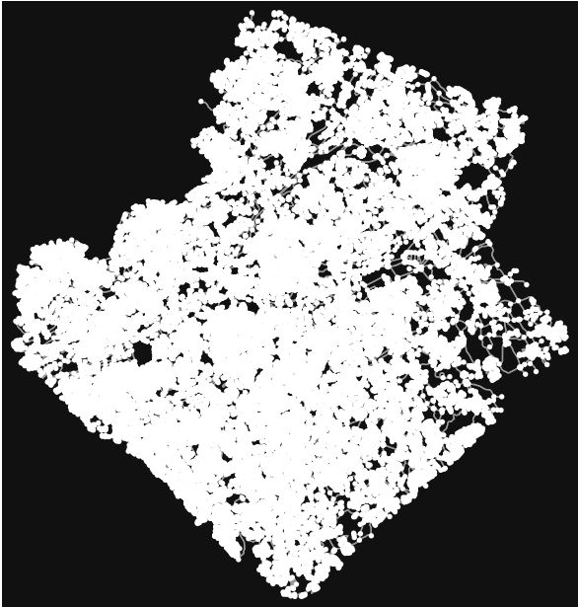
Synthetic Data Generation
- Gwinnett County map converted to directed graph with saved coordinates data of edges and nodes
- Bus calculates distance traveled off speed (m/s) * 5 second's along current edge
- Data collector receives all updates and sends to the producer
- In Progress:
Better bus route logic (from school to random location in the school radius and back)
Edit the time to simulate a real-life scenario of each bus traveling in morning before school to track whether bus is running on time
Gwinnett county represented as a strongly connected graph

Slide 7
SQL AND KAFKA install Documentation
MS SQL SERVER FOR LINUX RH9
Install:
sudo yum install -y mssql-server-selinux
Setup:
sudo /opt/mssql/bin/mssql-conf setup
Run/ ensure status
systemctl status mssql-server
connect:
sqlcmd -S RHEL9.xVM -U SA -P HootyHoo!
KAFKA:
$ sudo wget https://dlcdn.apache.org/kafka/3.8.0/kafka_2.13-3.8.0.tgz
After installing:
$ tar -xzf kafka_2.13-3.8.0.tgz $ cd kafka_2.13-3.8.0
Generate a Cluster UUID
$ KAFKA_CLUSTER_ID="$(bin/kafka-storage.sh random-uuid)"
Format Log Directories
$ bin/kafka-storage.sh format -t $KAFKA_CLUSTER_ID -c config/kraft/server.properties
Start the Kafka Server
$ bin/kafka-server-start.sh config/kraft/server.properties
Create a topic:
$ bin/kafka-topics.sh --create --topic TOPICNAME --bootstrap-server localhost:9092

Slide 8

Data FLow

Slide 9
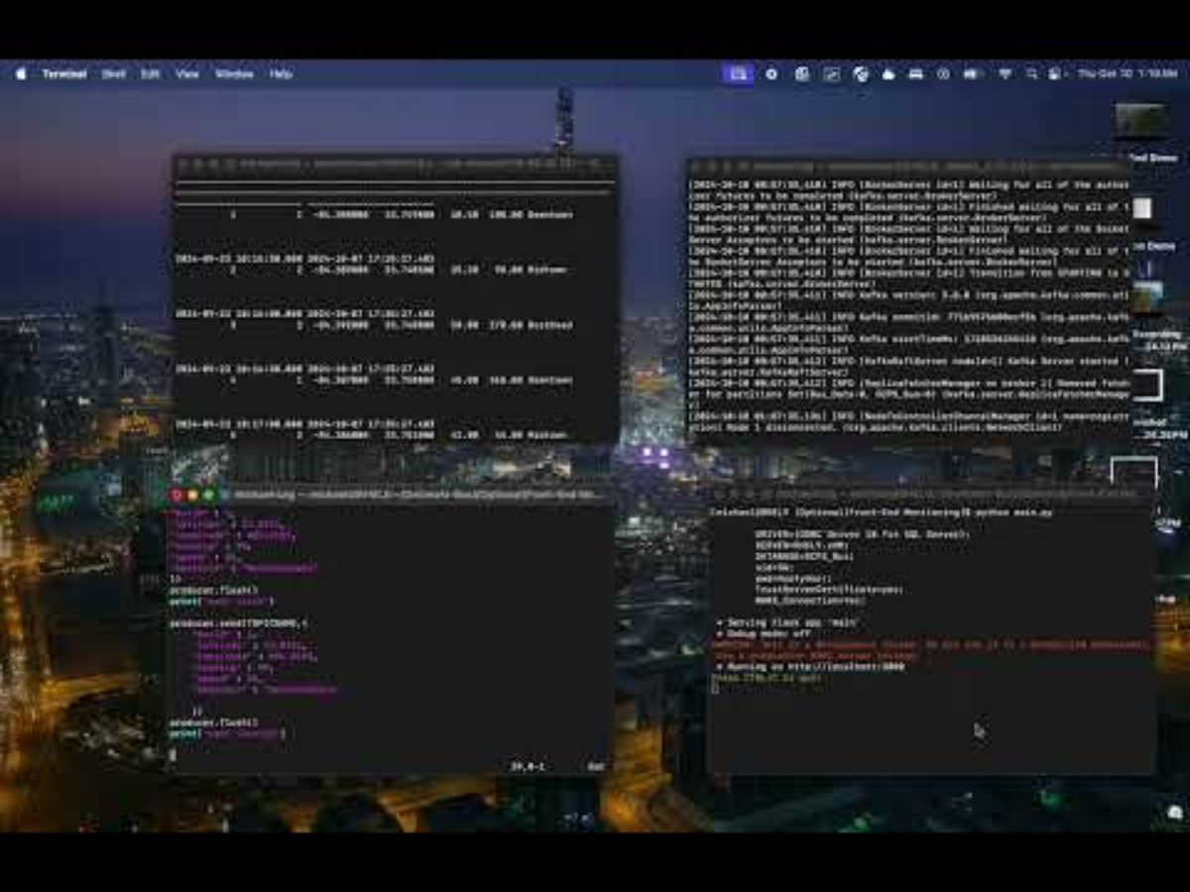
Data Validation

Slide 10
Next steps
Testing/QA: Running unit testing in scale, utilizing up to 2000 simultaneous bus inputs to simulate a realistic workload scenario and possibly test more for growth.
Containerization: Utilizing Podman to containerize our project for simplicity, scalability and deployment.
Bonus:
Front End: Revamping the front end to highlight stale data, and filtering for bus id, late status, geofence, etc.

